Slide 1

Deeplearning-deepdive
Raghu Prasad Konandur
9845547471
www.kaushalya.tech
raghuprasadkonandur@kaushalya.tech

Slide 2
Deep Learning
Why deep learning is becoming popular
Data Growth
Hardware Advancements
Python and Open Source Eco System
Cloud and AI boom

Slide 3
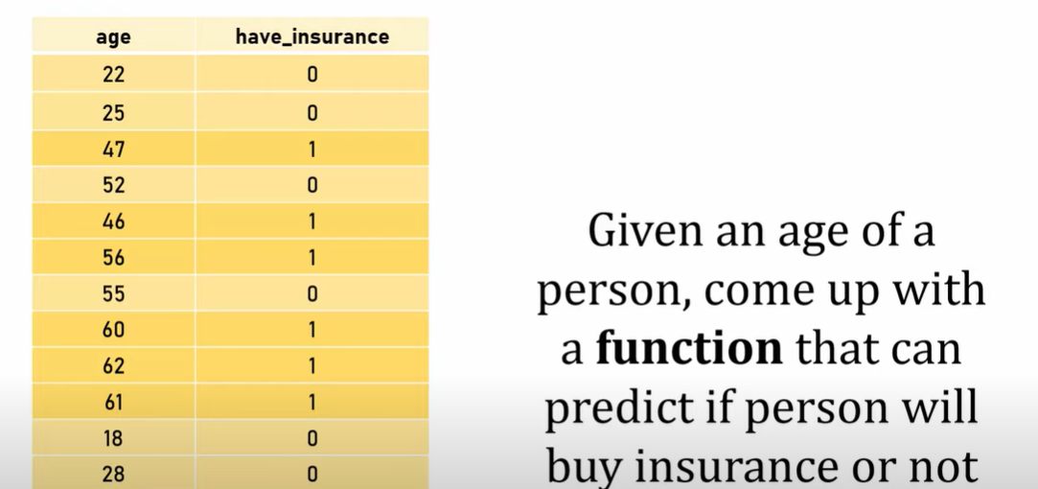
Example

Slide 4
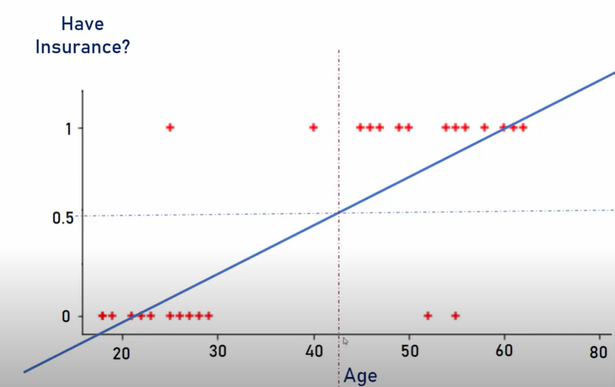
Problem with linear model

Slide 5
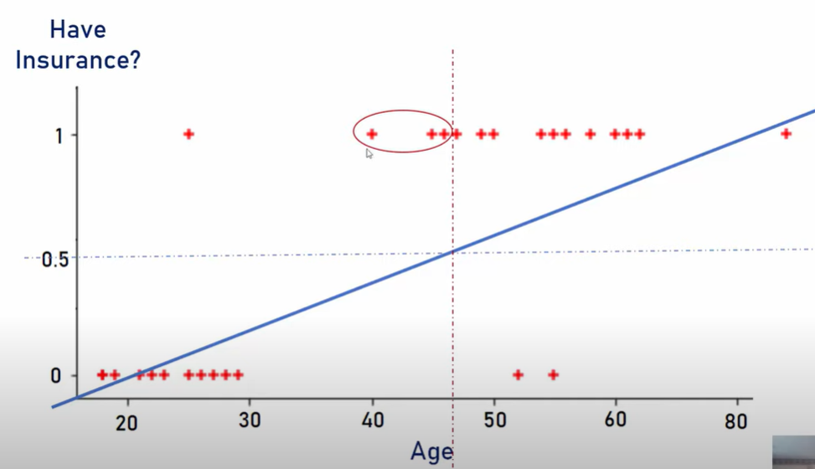
Problem with linear model

Slide 6
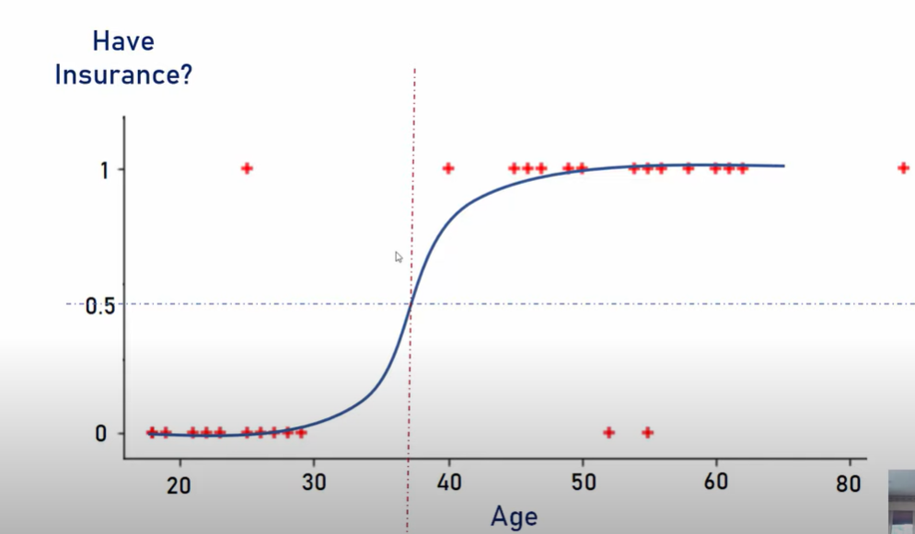
Non-linear model

Slide 7
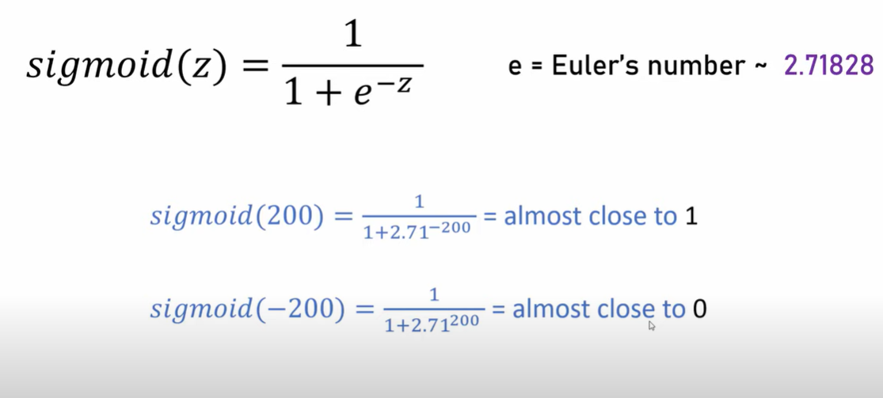
Sigmoid Function

Slide 8
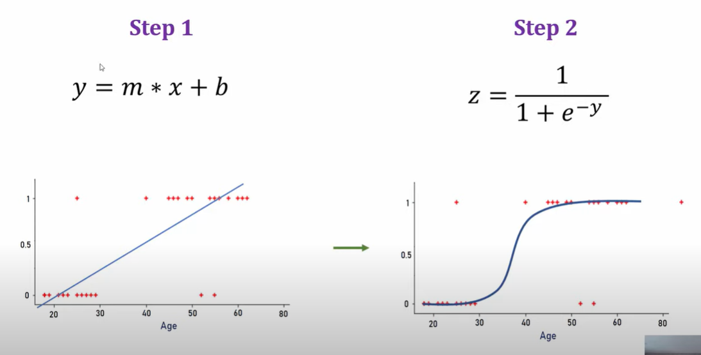
Sigmoid Function

Slide 9
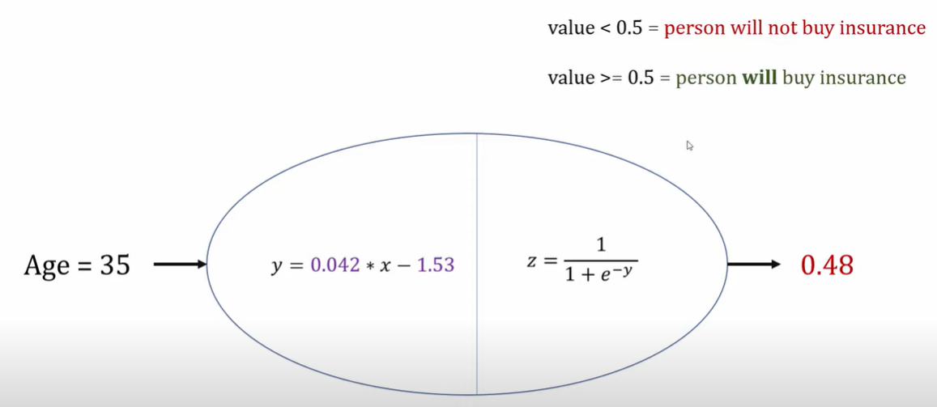
Neuron

Slide 10
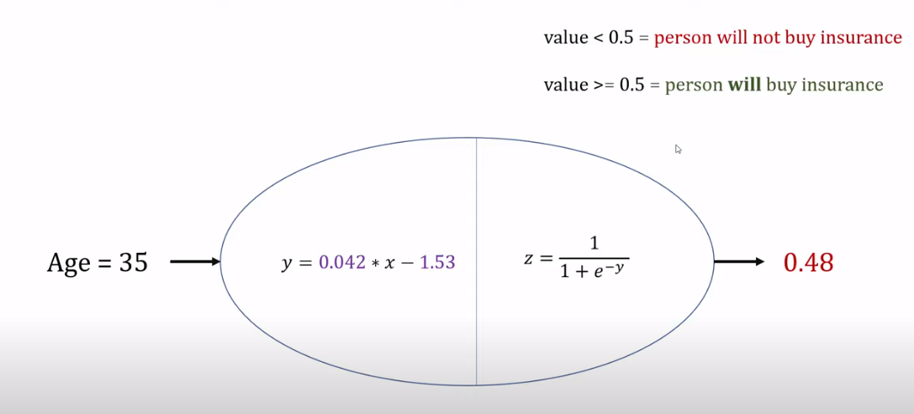
Neuron

Slide 11
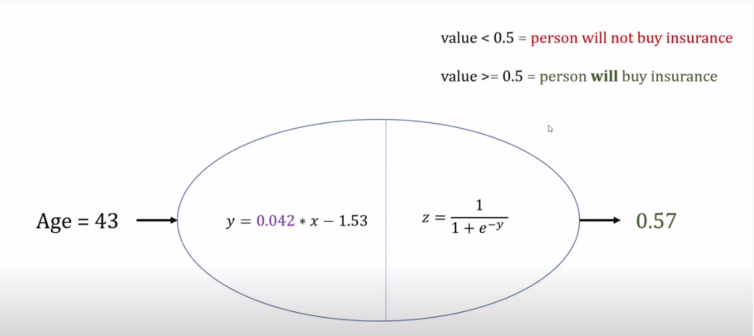
Neuron

Slide 12
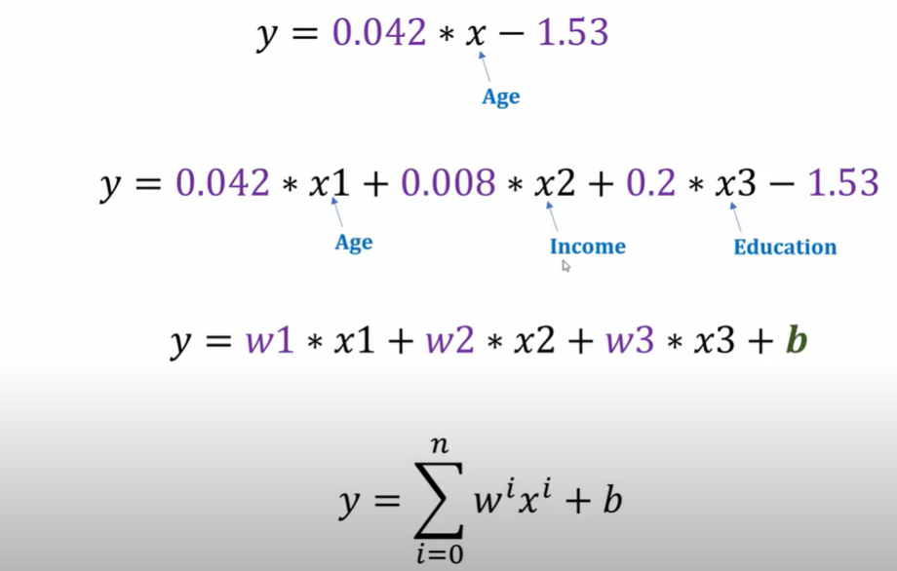
Neuron

Slide 13
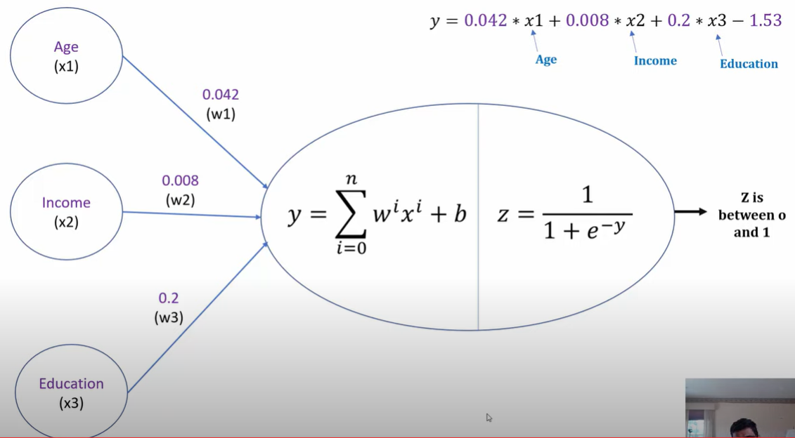
Neuron

Slide 14
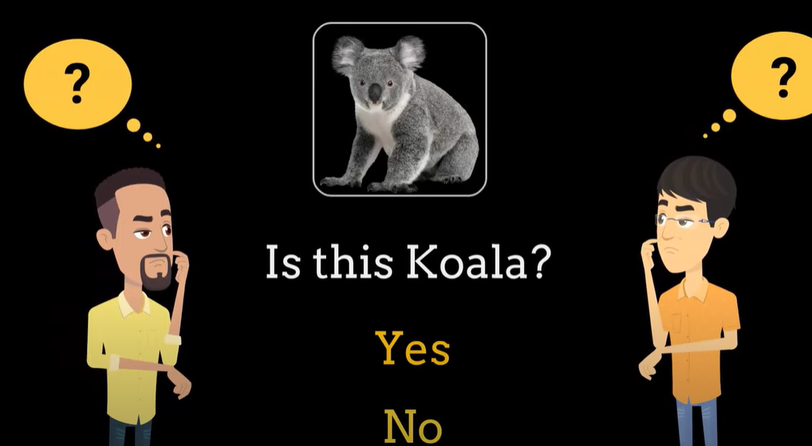
Simple Neural Network

Slide 15
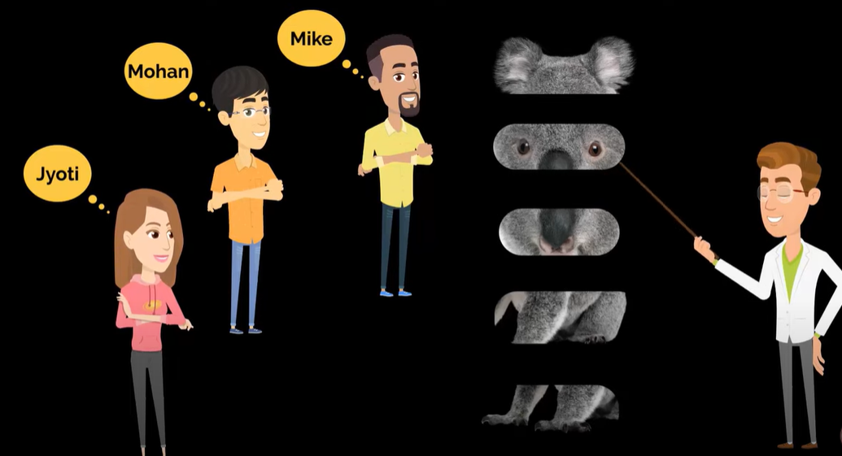
Simple Neural Network

Slide 16
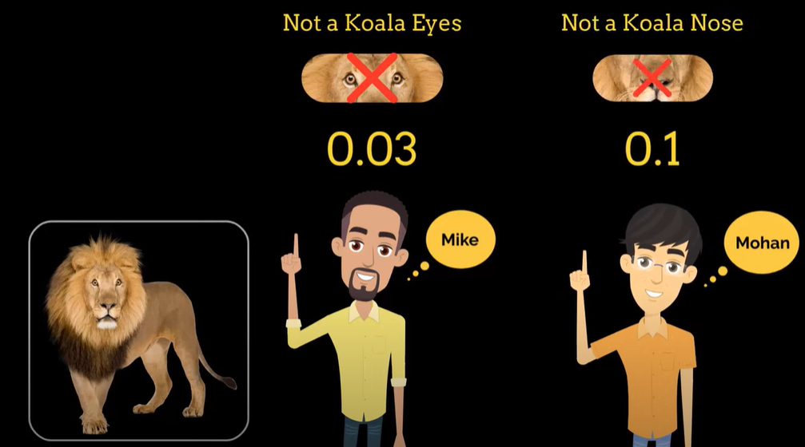
Simple Neural Network

Slide 17
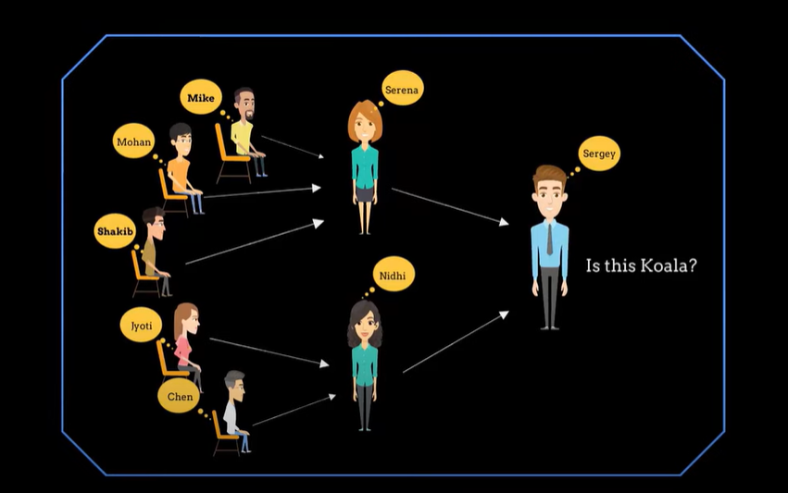
Neural Network

Slide 18
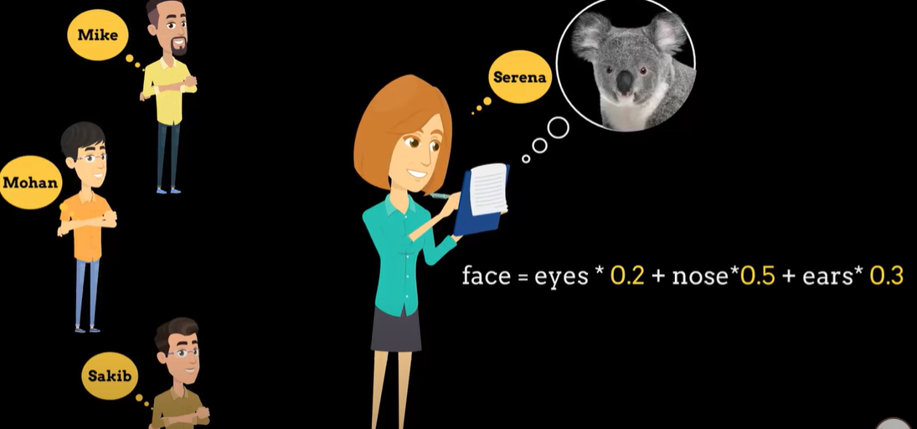
Neural Network

Slide 19
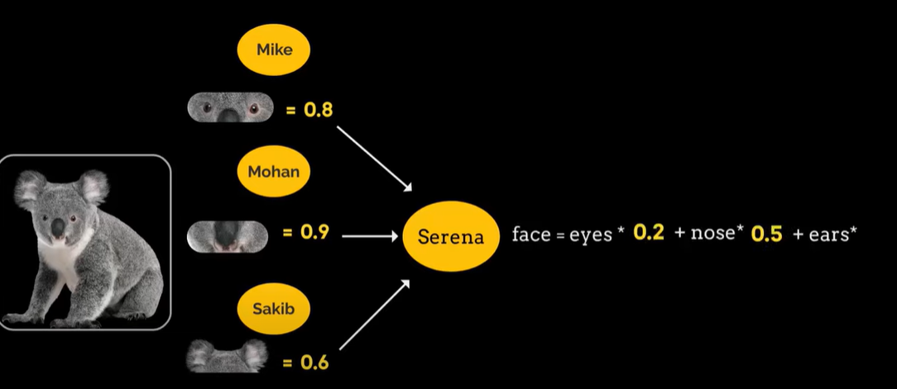
Neural Network

Slide 20
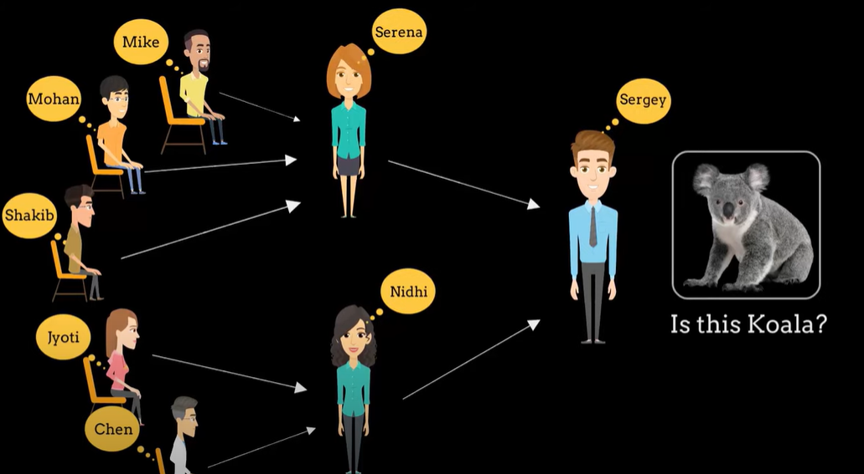
Neural Network

Slide 21
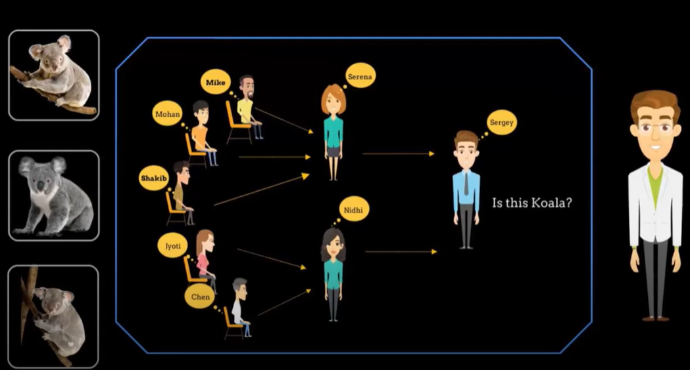
Neural Network

Slide 22
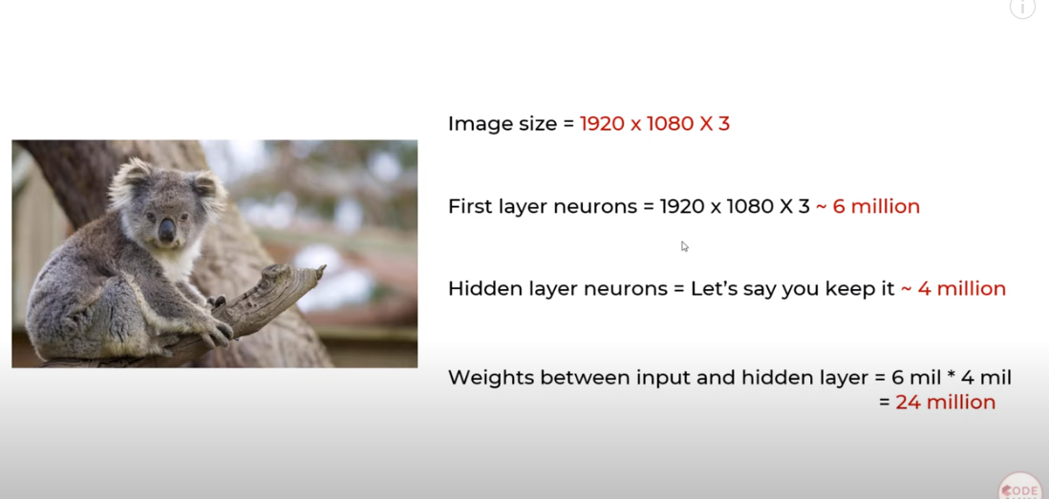
Convolution Neural Network (CNN)

Slide 23
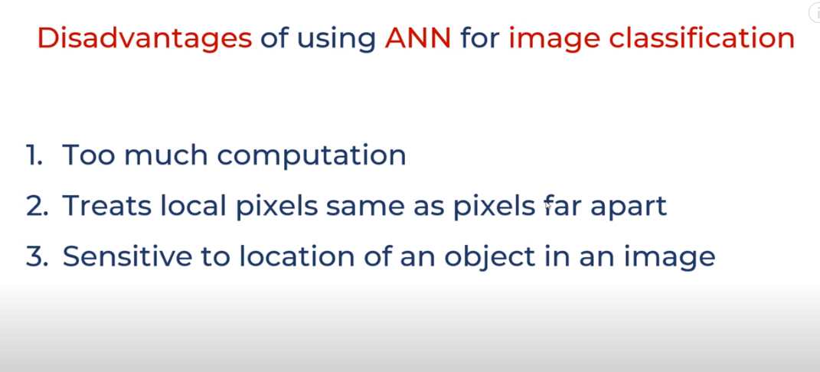
CNN

Slide 24
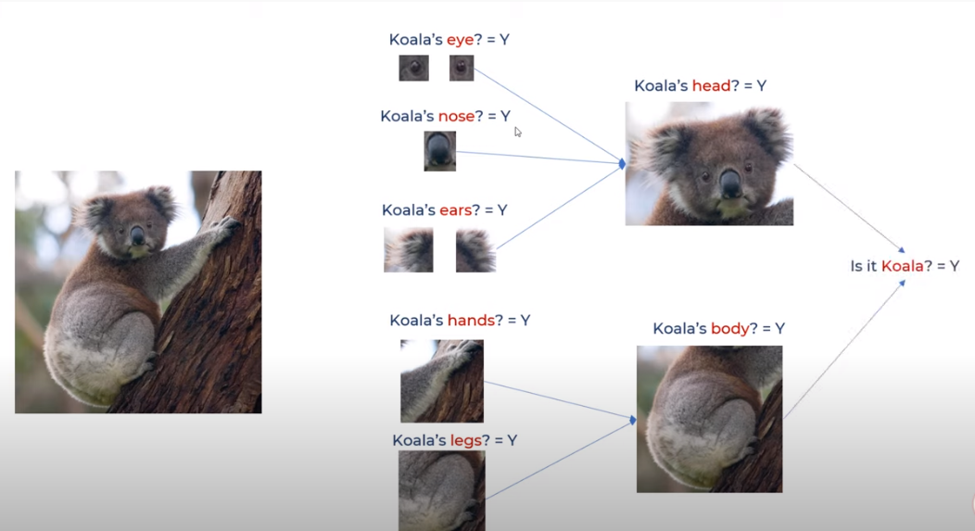
CNN

Slide 25
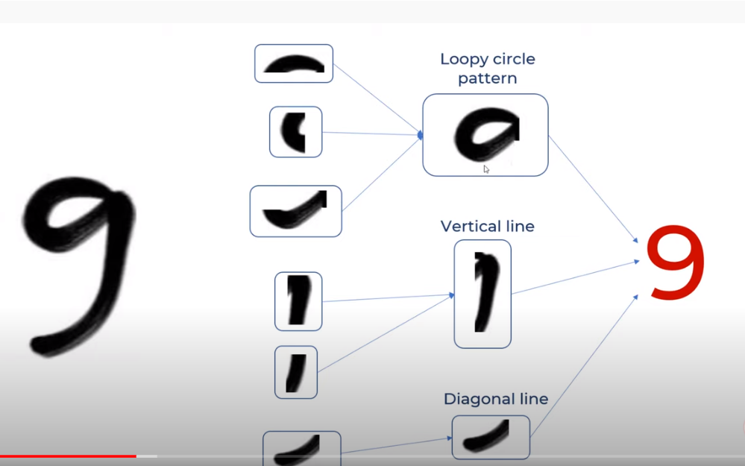
CNN

Slide 26
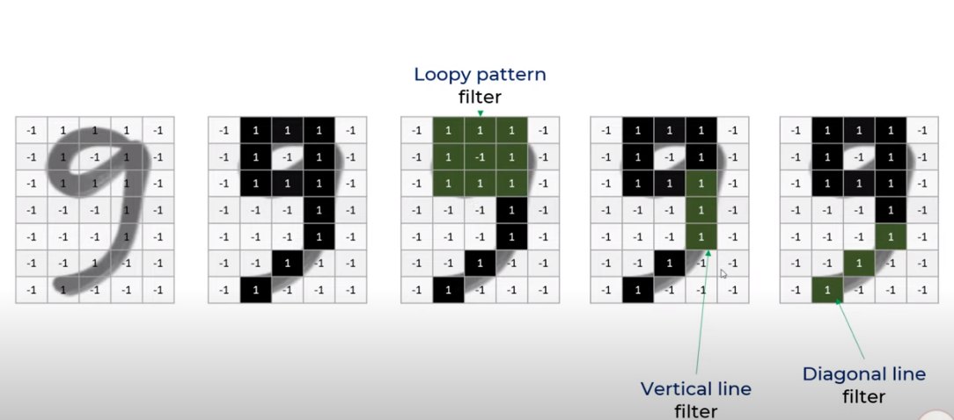
CNN

Slide 27
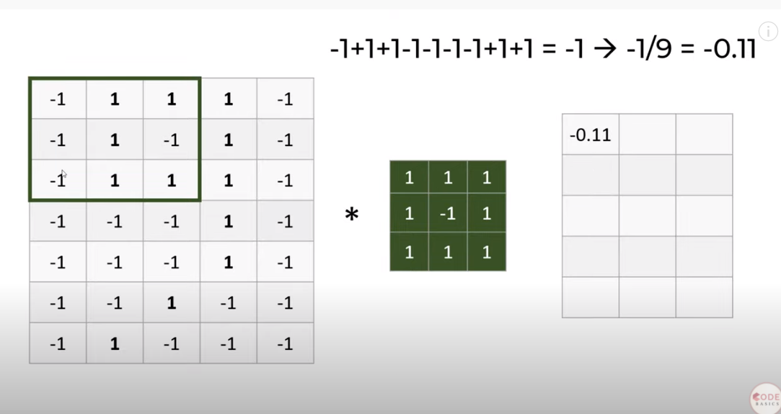
Convolution- 1st Multiply

Slide 28
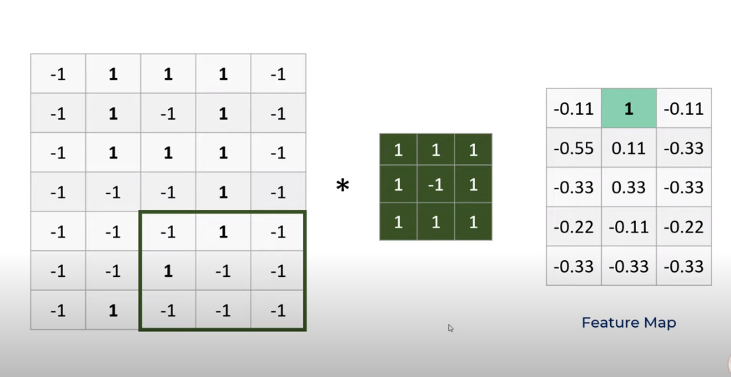
Feature map

Slide 29
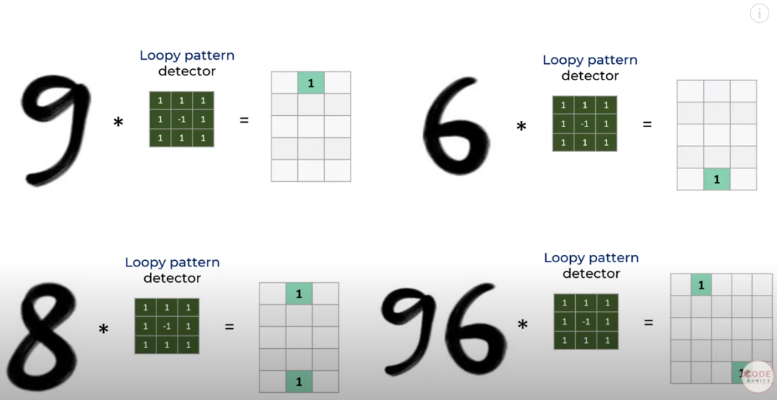
Feature map

Slide 30
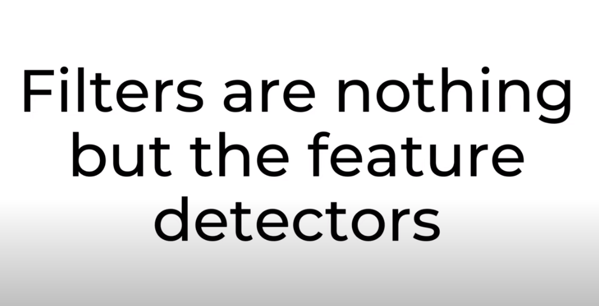
Filters

Slide 31
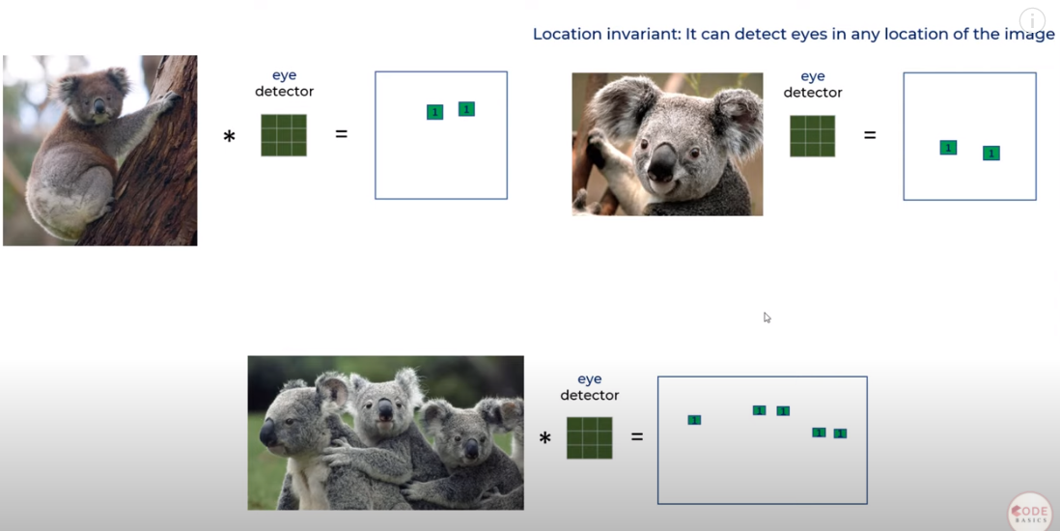
Filter map

Slide 32
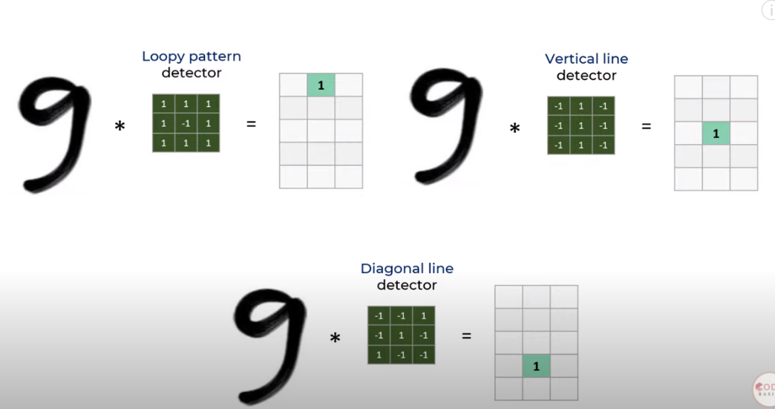
Filter map

Slide 33
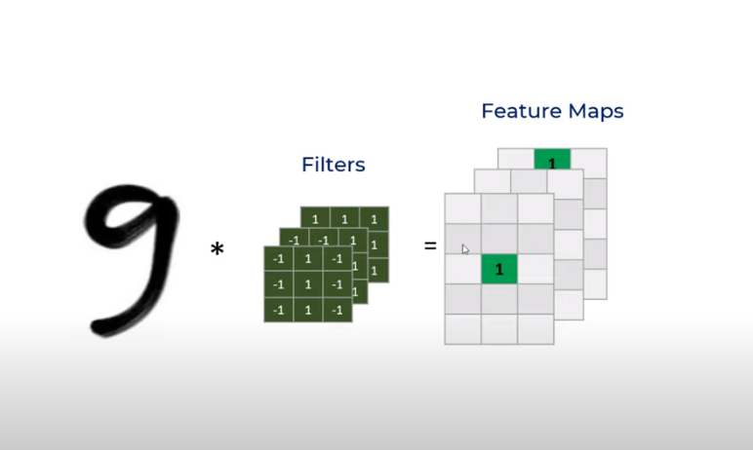
Feature map

Slide 34
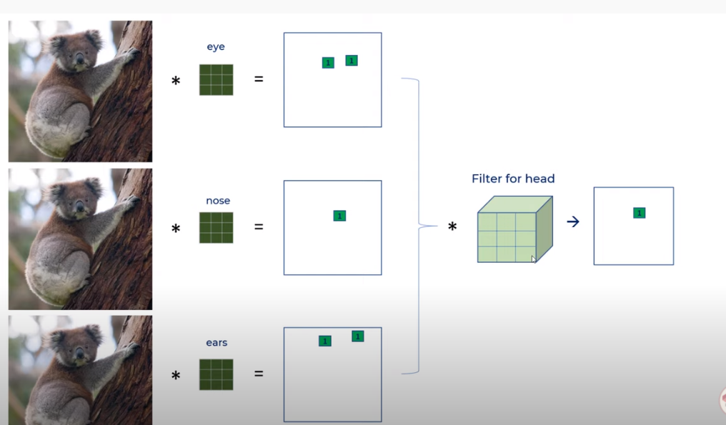
Feature map

Slide 35
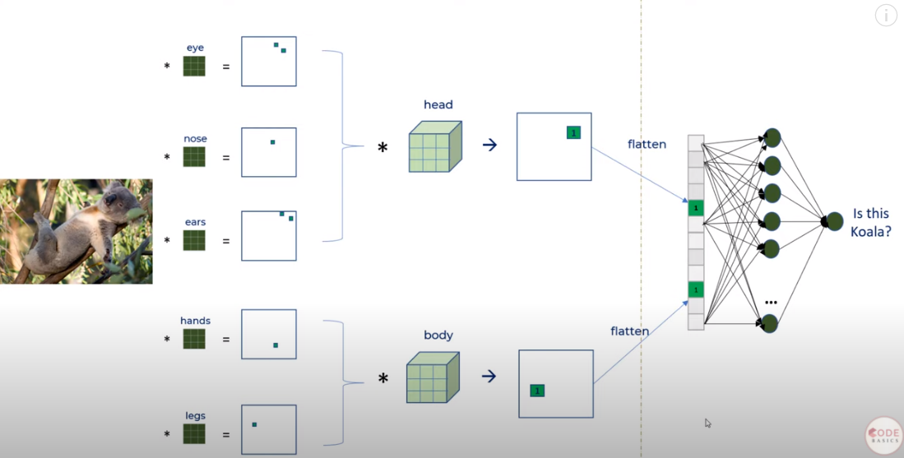
Neural network

Slide 36
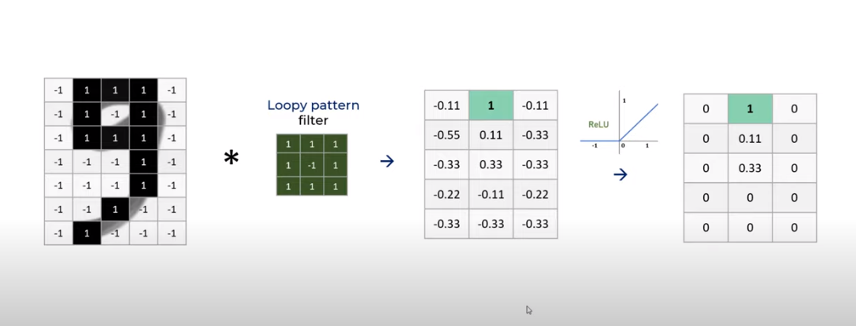
Relu

Slide 37

Relu

Slide 38
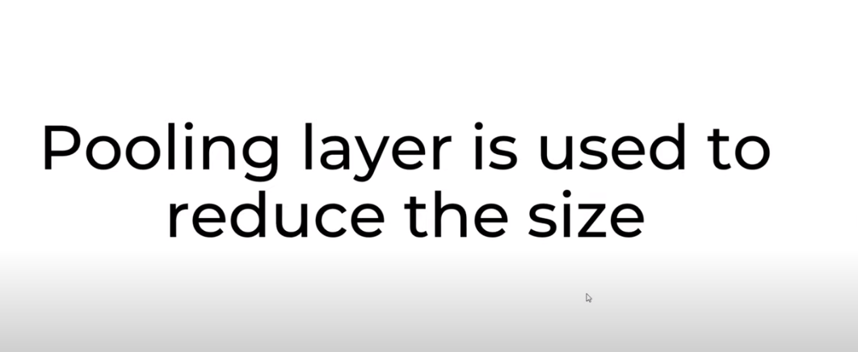
Pooling layer

Slide 39
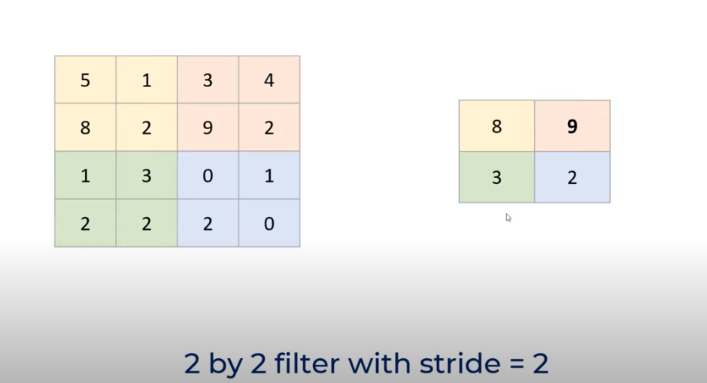
Max Pooling

Slide 40
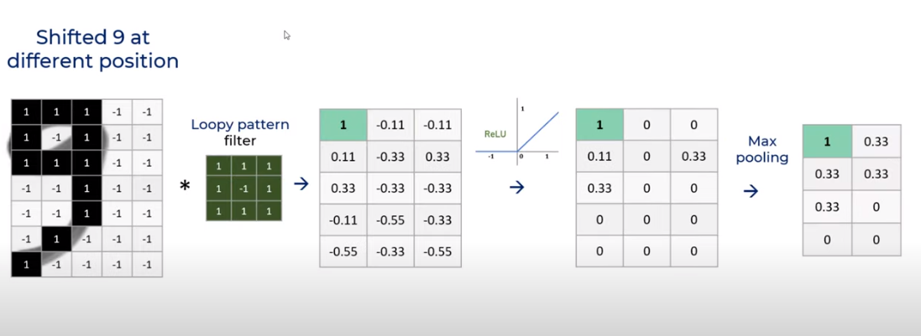
Max pooling

Slide 41
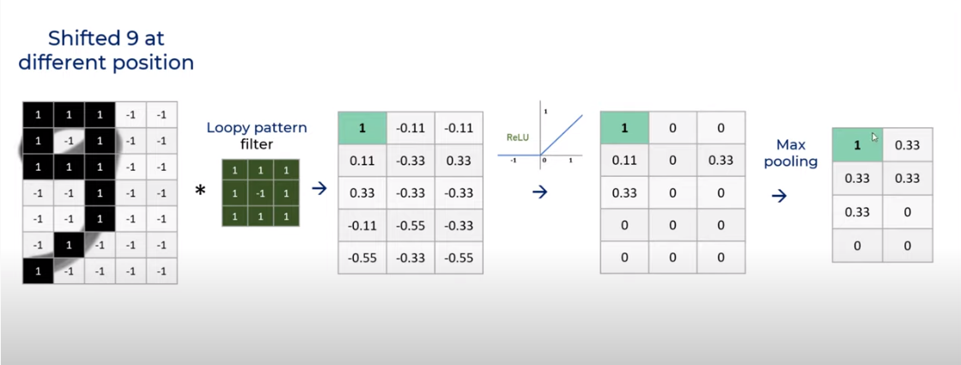
Max pooling

Slide 42
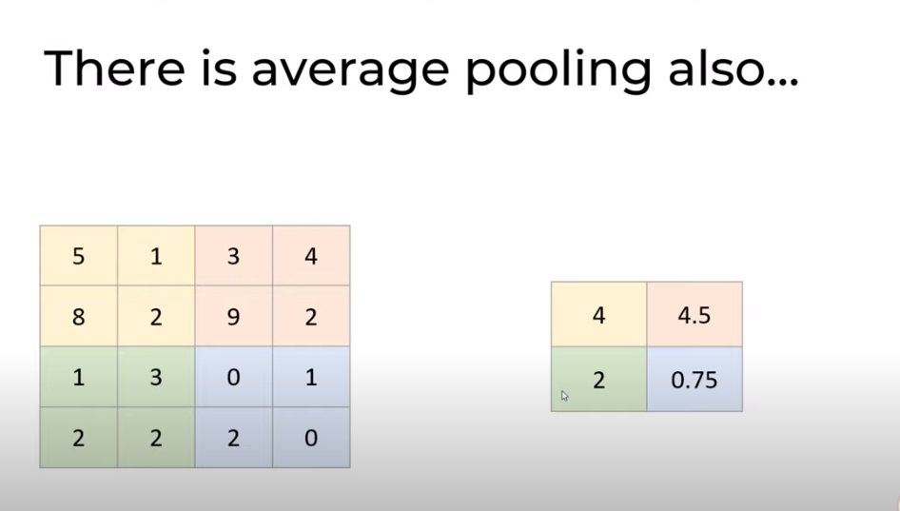
Average pooling

Slide 43
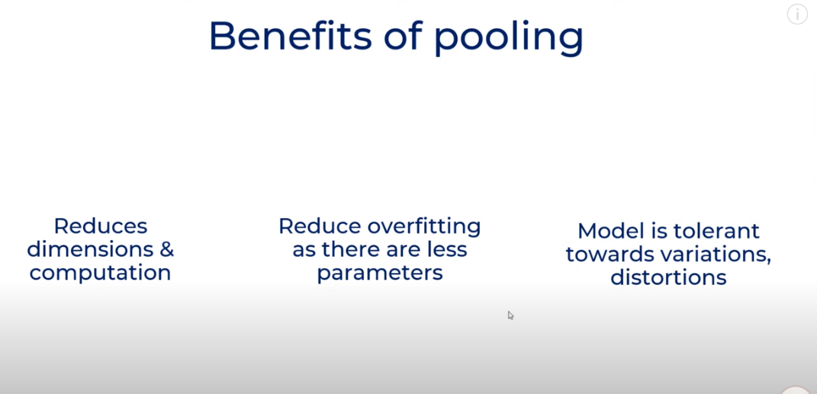
Pooling benefits

Slide 44
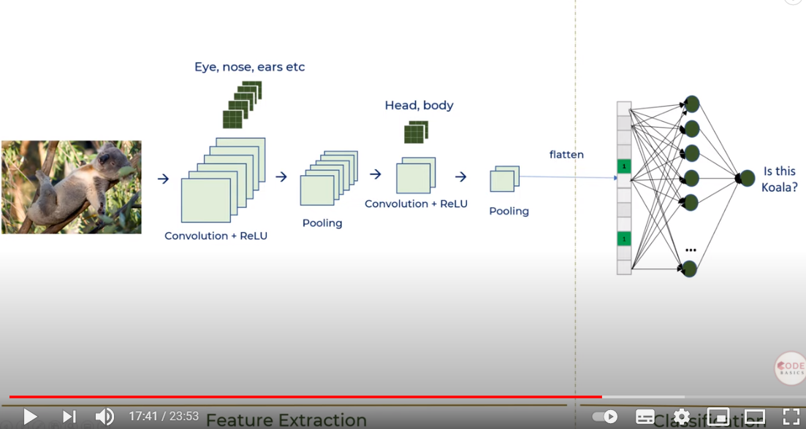
CNN

Slide 45
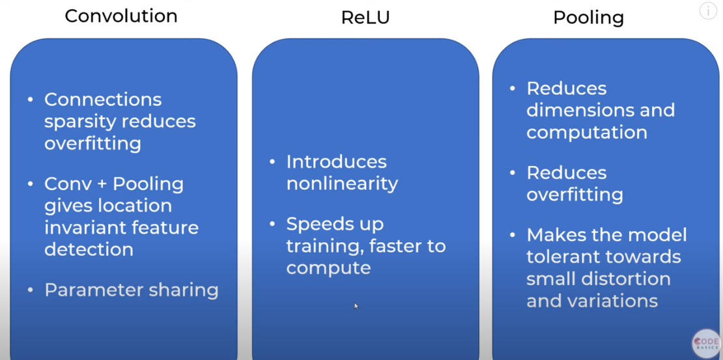
Key items

Slide 46
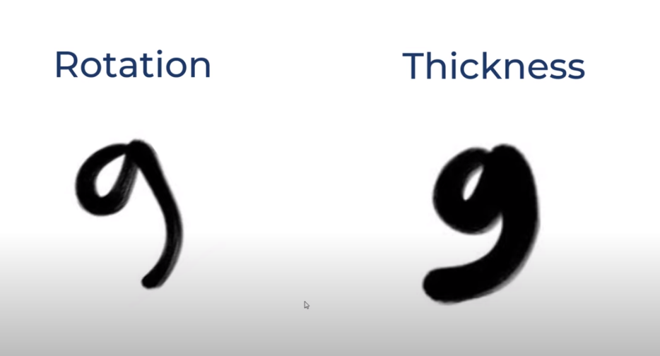
Rotation and scaling

Slide 47
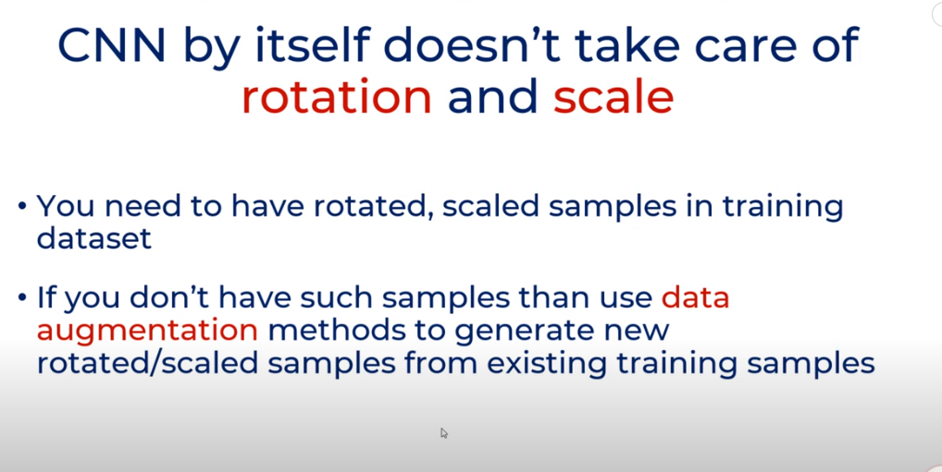
Rotation and scaling

Slide 48
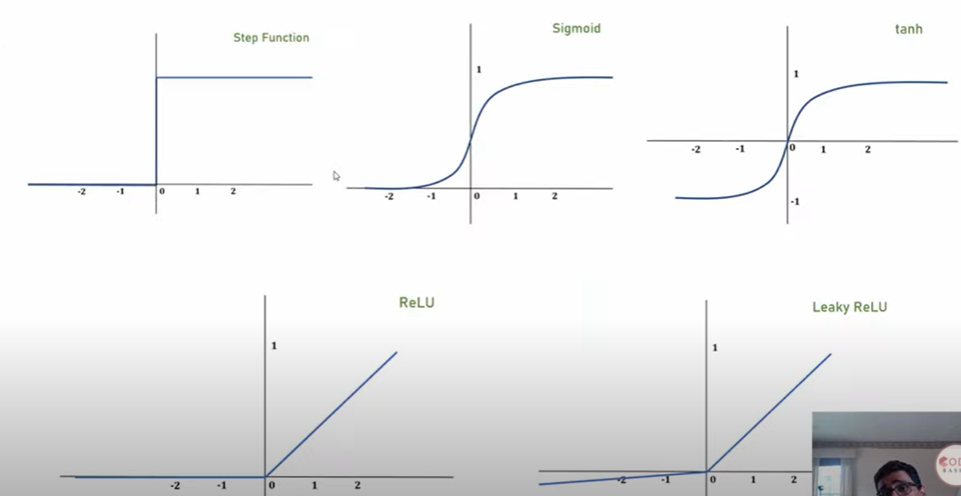
Activation Functions

Slide 49
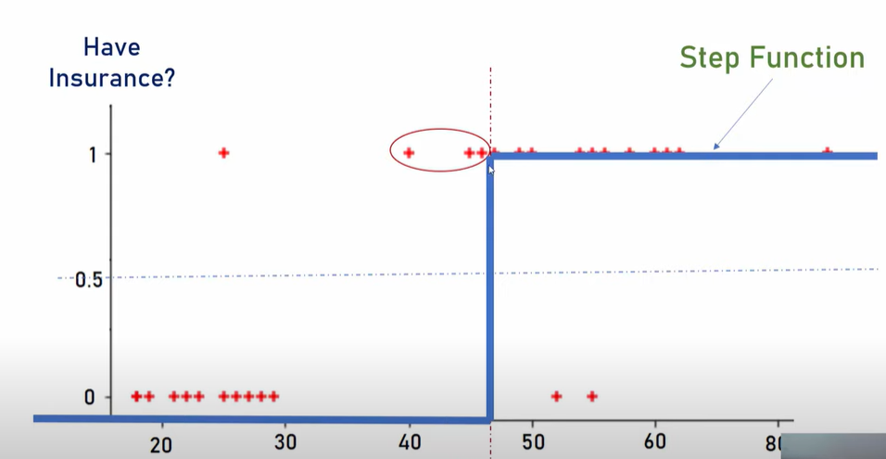
Step Function

Slide 50
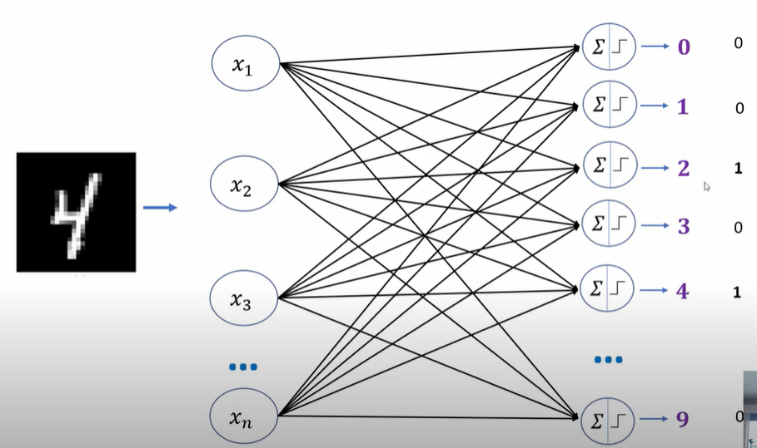
Step Function problem

Slide 51
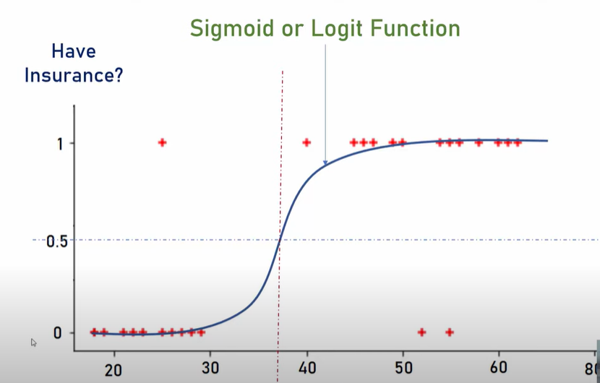
Sigmoid Function

Slide 52
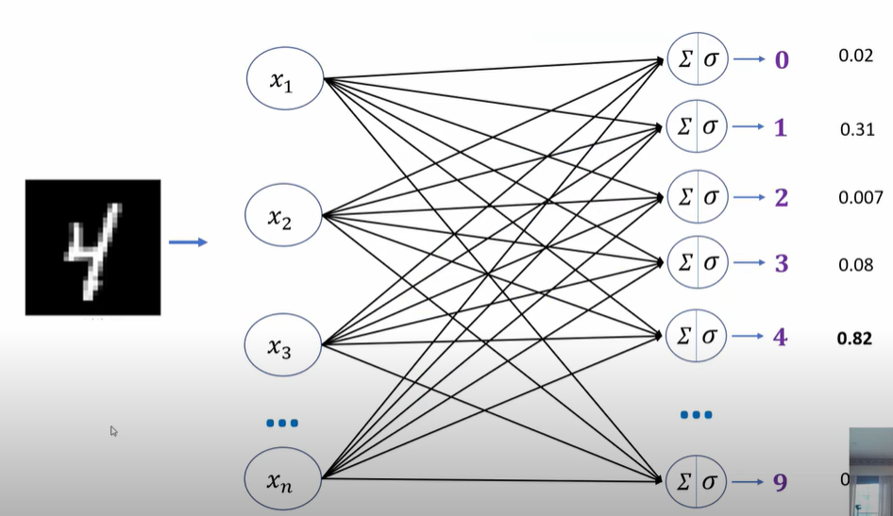
Sigmoid Function

Slide 53
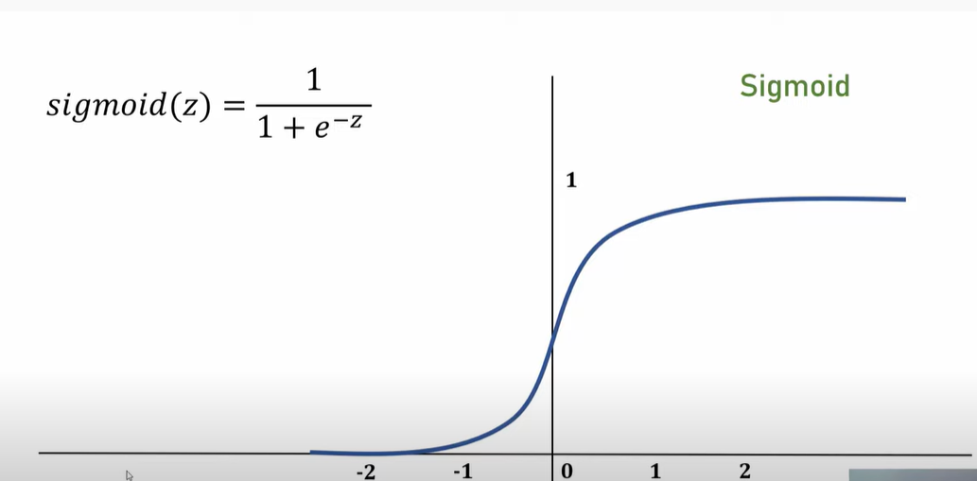
Sigmoid Function

Slide 54

tanh

Slide 55


Slide 56

Issues with Sigmoid and tanh

Slide 57

ReLU

Slide 58


Slide 59

Leaky ReLU

Slide 60

Activation Functions and Loss Functions for neural networks

Slide 61

Derivatives

Slide 62

Derivatives

Slide 63

Derivatives

Slide 64

Derivatives

Slide 65

Derivatives

Slide 66

Derivatives

Slide 67

Partial Derivative

Slide 68

Derivatives

Slide 69

Derivatives

Slide 70

Derivatives

Slide 71
References
https://medium.com/analytics-vidhya/activation-functions-and-loss-functions-for-neural-networks-how-to-pick-the-right-one-542e1dd523e0
https://www.analyticsvidhya.com/blog/2021/07/demystifying-the-difference-between-multi-class-and-multi-label-classification-problem-statements-in-deep-learning/
https://www.tensorflow.org/guide/tensor

Slide 72
Thank You
Raghu Prasad Konandur
9845547471
www.kaushalya.tech
raghuprasadkonandur@kaushalya.tech

